Slide 1

Quantum Cryptography Project
The New Age of Security

Slide 2
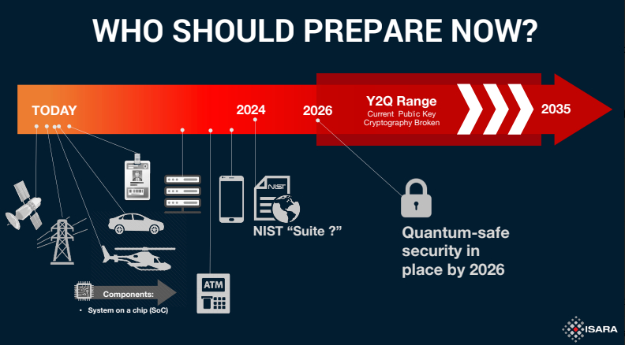
The Problem
As of 2017, 85.9% of office-based physicians are using electronic medical record systems to store and transmit patient data.
By 2030, RSA encryption will be obsolete.

Slide 3
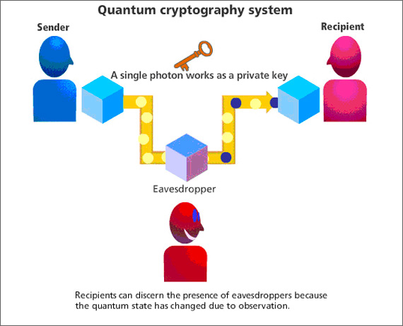

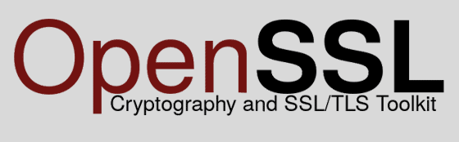

Slide 4
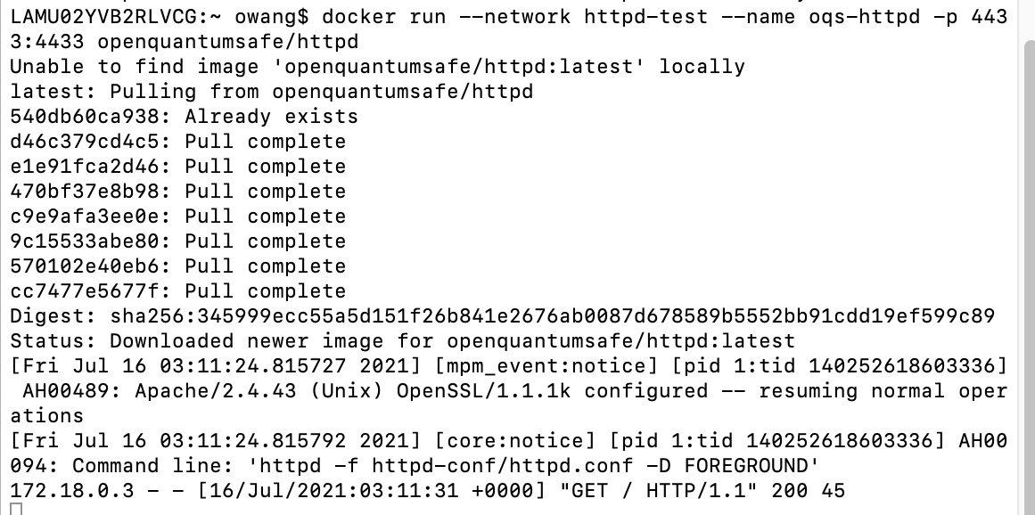
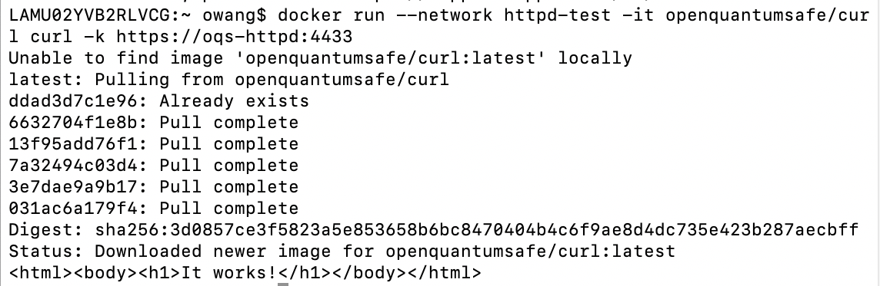
Terminal 1
1. Start server through terminal
2. Test page retrieved
Terminal 2
2. Retrieving a test page
3. Test page contents

Slide 5

1. Running server
2. Retrieving page

Slide 6
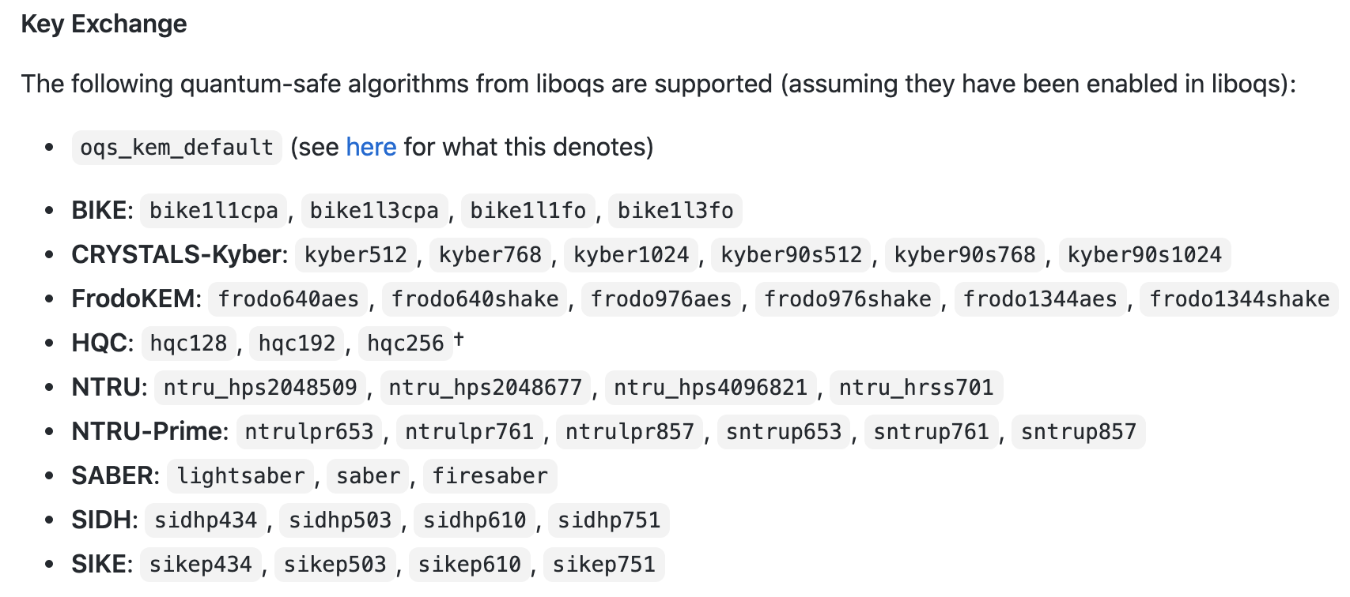
Algorithms
NIST Finalists
CRYSTALS-KYBER
NTRU
SABER

Slide 7
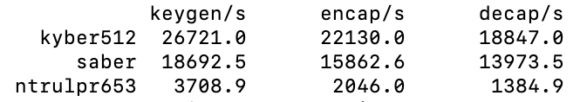
Performance

